Slide 1
Making Career Connections
Alyssa Johnston,
Career Development Coordinator
5.9.2018
goo.gl/B6GLjm

Slide 2
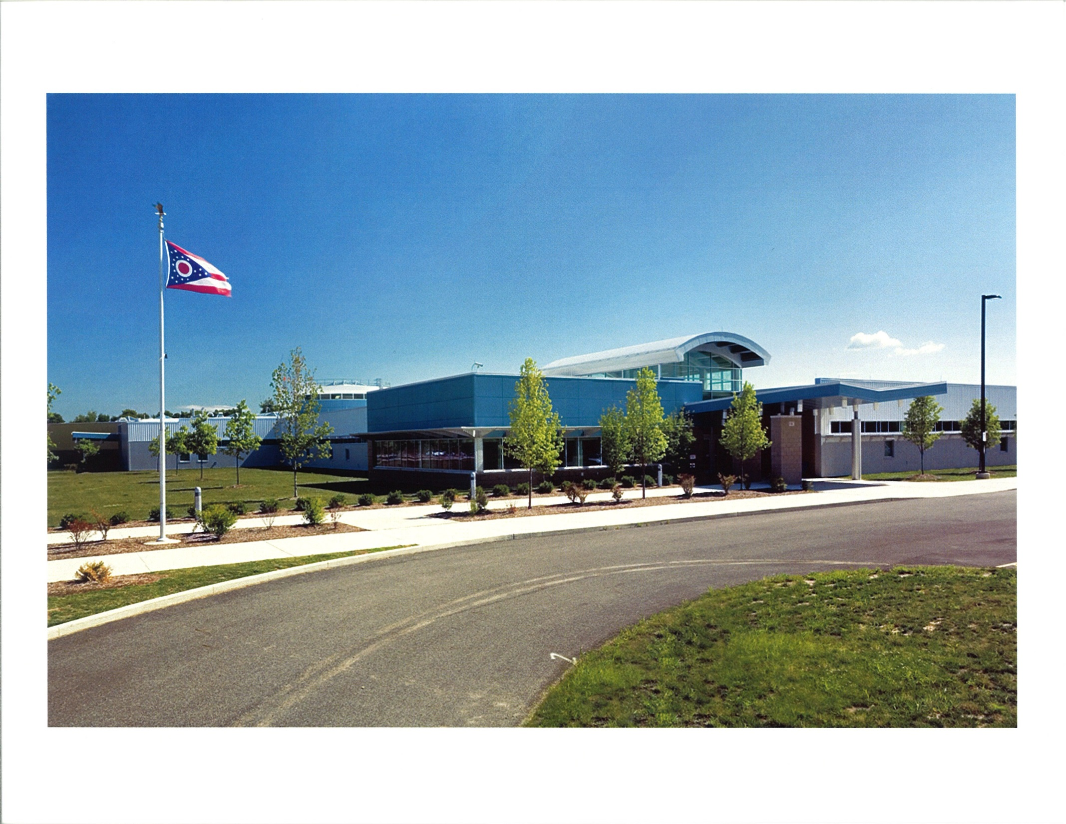

Slide 3
C-TEC: Overview
11 Associate Schools
Approximately 700 students on site
7 High School Satellite Programs
7 Middle School Programs
Adult Education
26 Programs

Slide 4
Who is in the room?
Business and Industry?
Career Tech Principals/Teachers?
Primary Principals/Teachers?
Middle School Principals/Teachers?
High School Principals/Teachers?
Other

Slide 5
Career Development K-12
K-5
  Teacher PD
  Classroom Visits
  Career Day Activities
6-8
  Teacher PD
  Middle School Program support
    (owned and unowned)
  8th Grade Experience
9-12
  9th Grade: Requested Activities
  10th Grade: Sophomore Hands-On & Evening of Exploration
  11th Grade: CareerXpress & Project Prepare
  12th Grade: Senior Spotlight & Requested Activities
All grade levels- Open House & Evening of Exploration

Slide 6
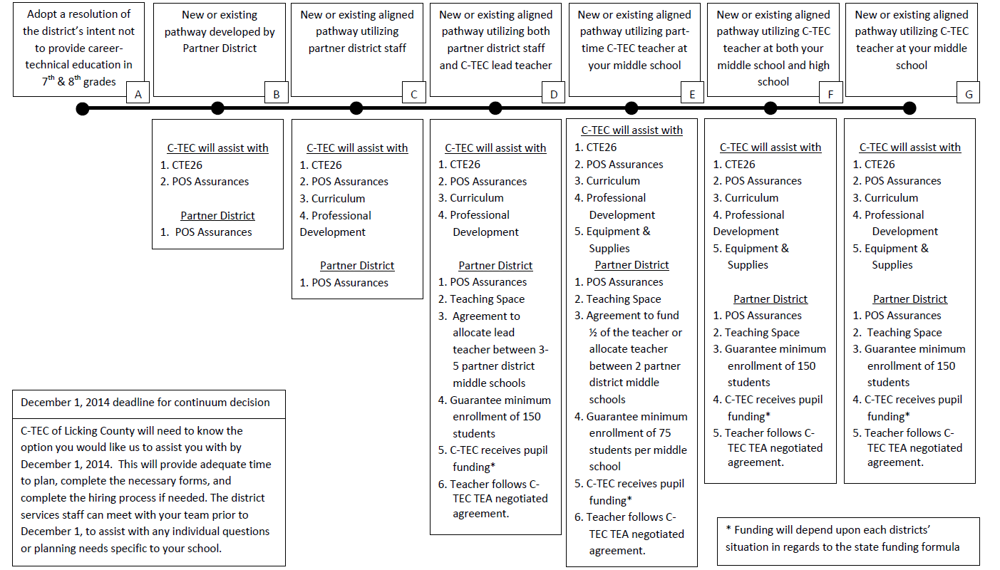
Middle School Collaboration Continuum

Slide 7
Primary School Opportunities:
Teacher PD
Career Lab (in development)
Career Day Participation

Slide 8
Middle School Programs:
Heath: Pre-Engineering
Licking Heights: Career Connections
Utica: Career Connections
Heath: Career Connections
Lakewood: Information Technology
Granville: Information Technology
Licking Valley: Pre-Engineering
Licking Heights: Pre-Engineering

Slide 9
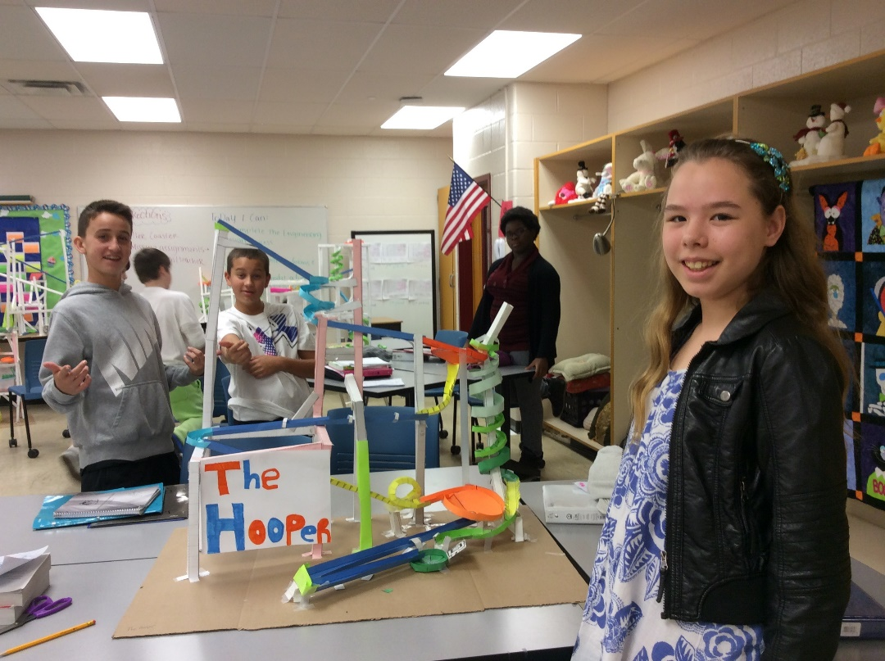
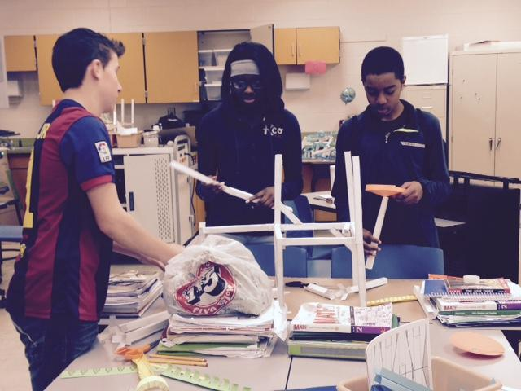
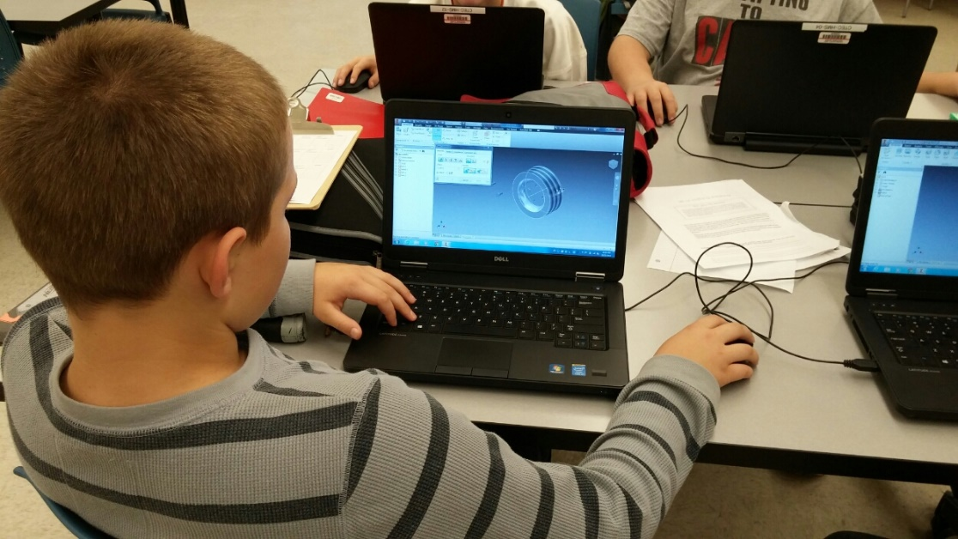
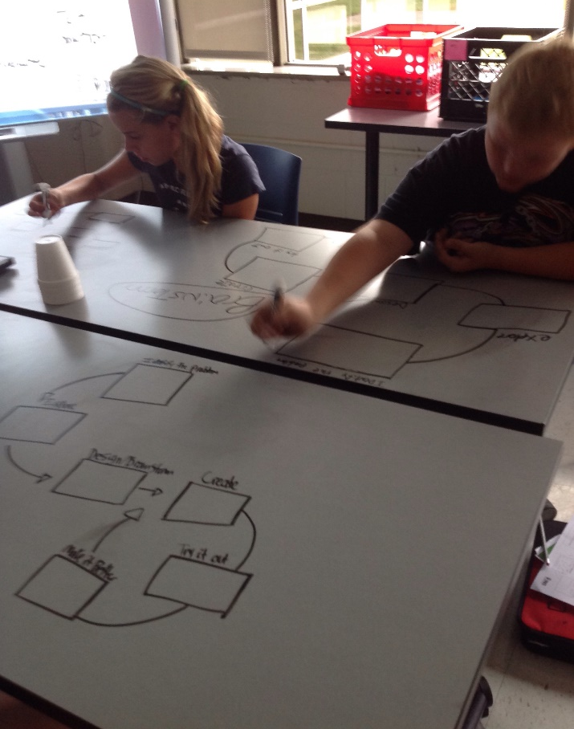

Slide 10
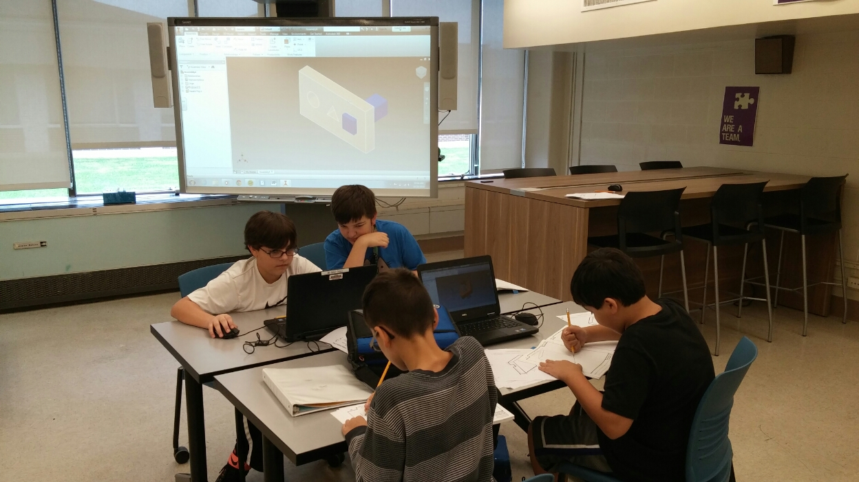
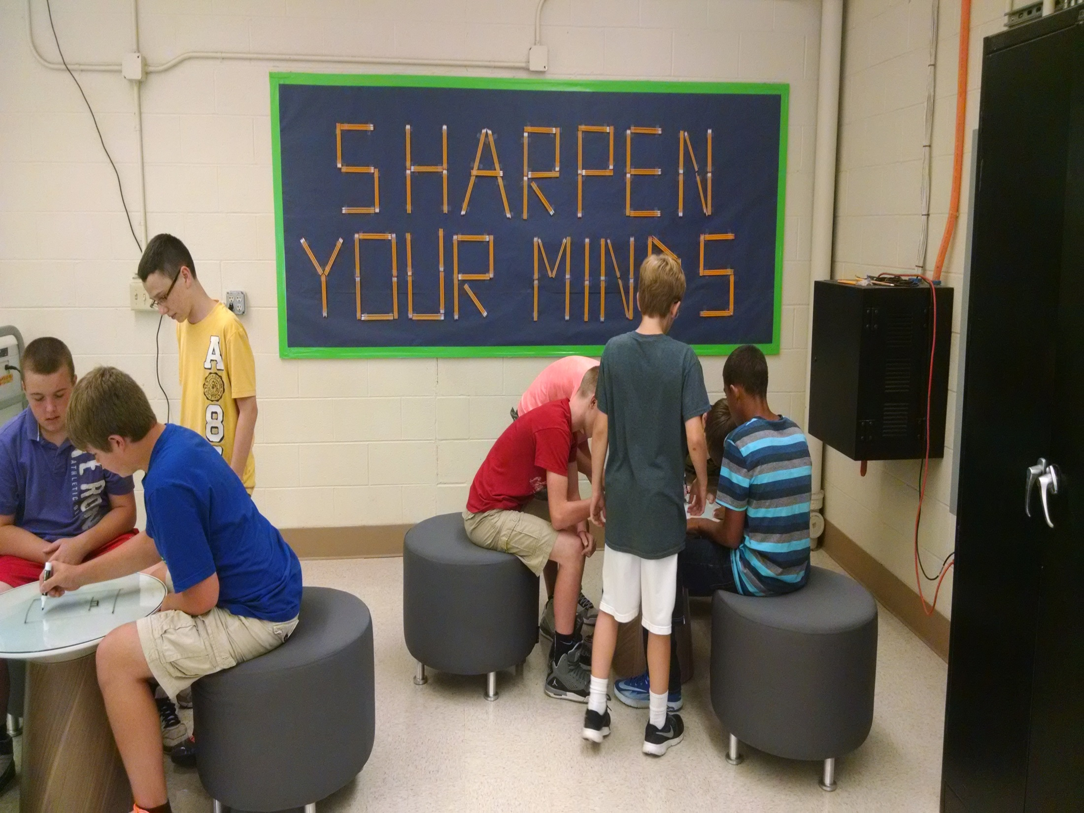
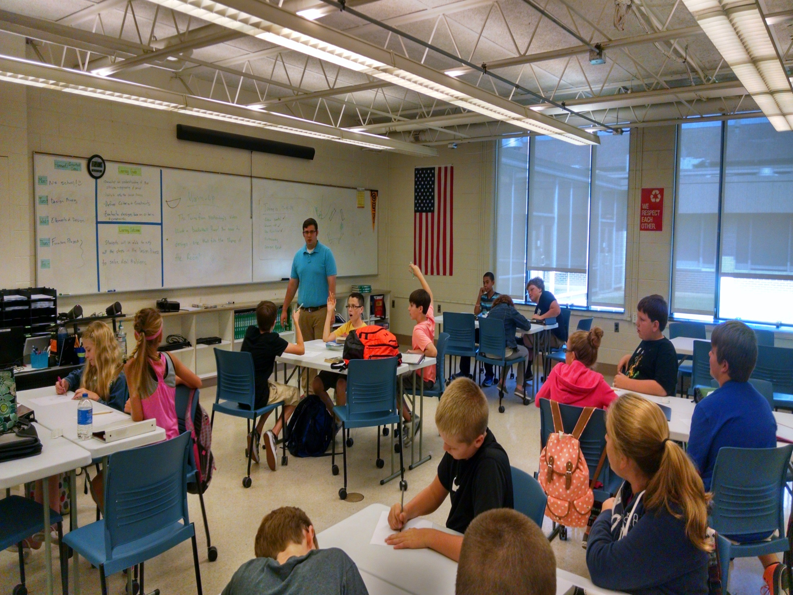



Slide 11
What about the other schools?
Un-owned middle school programs in the County = 6
Why is it important?
-positive relationships
-better experiences for our LC youth
-a support system for our teachers

Slide 12
PD Goals
Create a countywide network of CTE teachers
  Share lesson plans and laboratory projects
  Share best practices in teacher logistics
  Share resources
  Build teamwork and collaboration

Slide 13
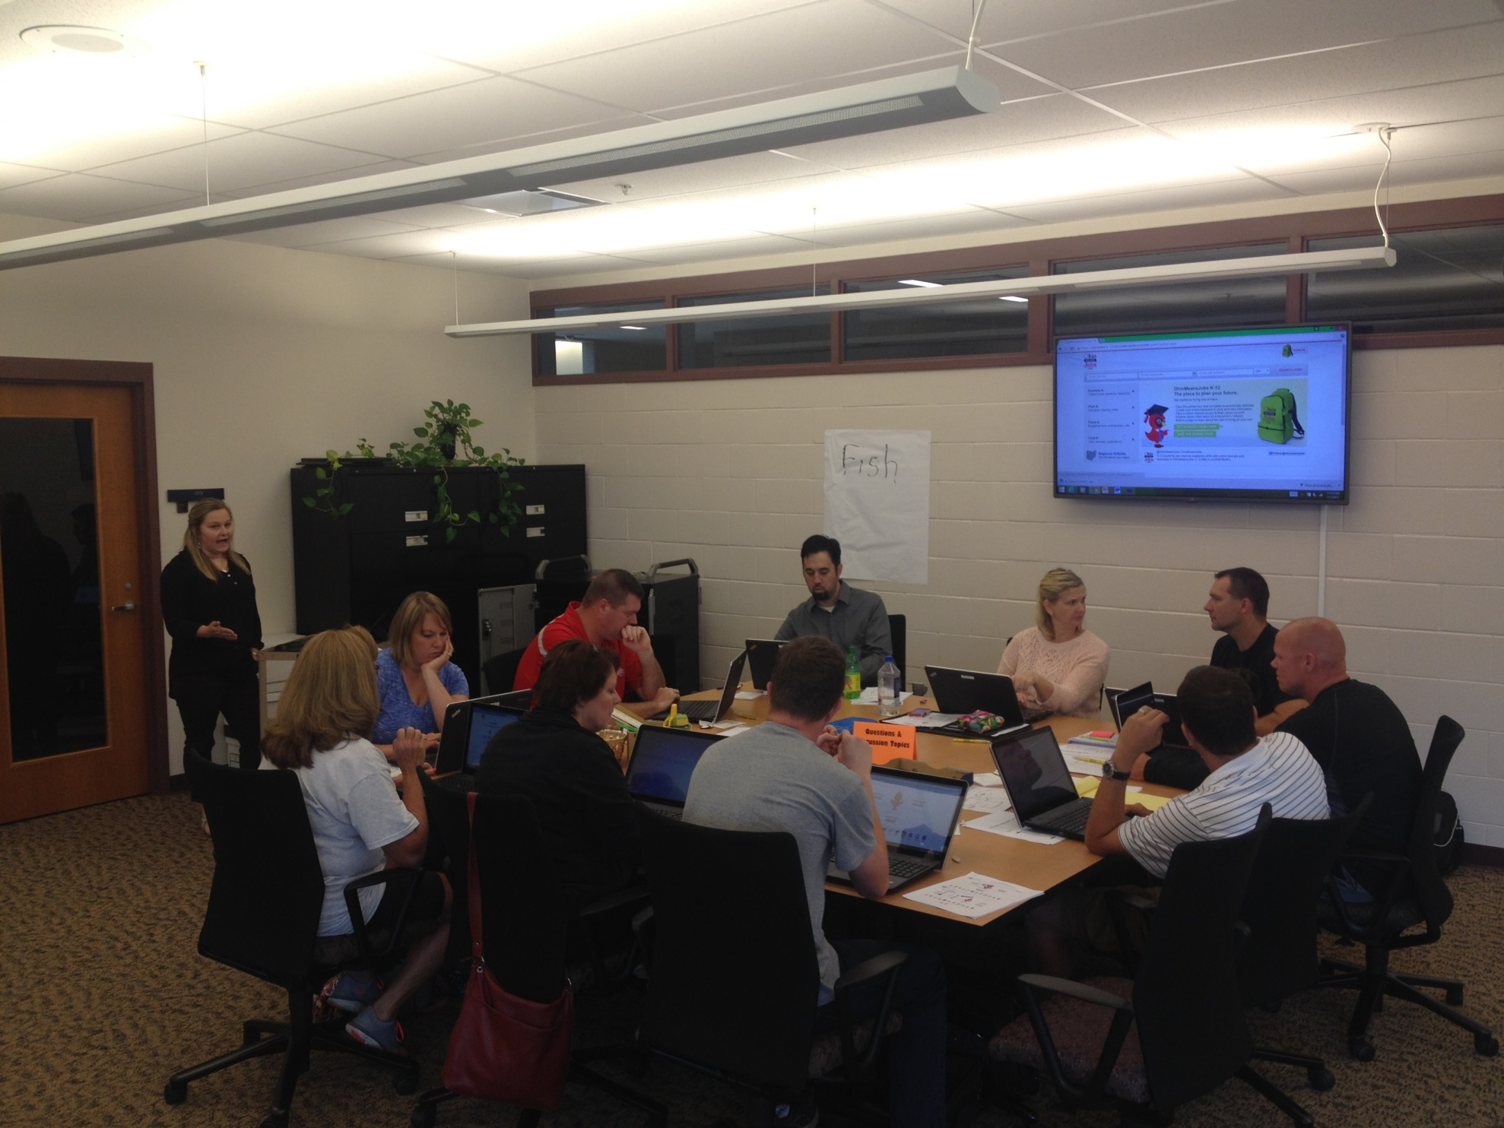
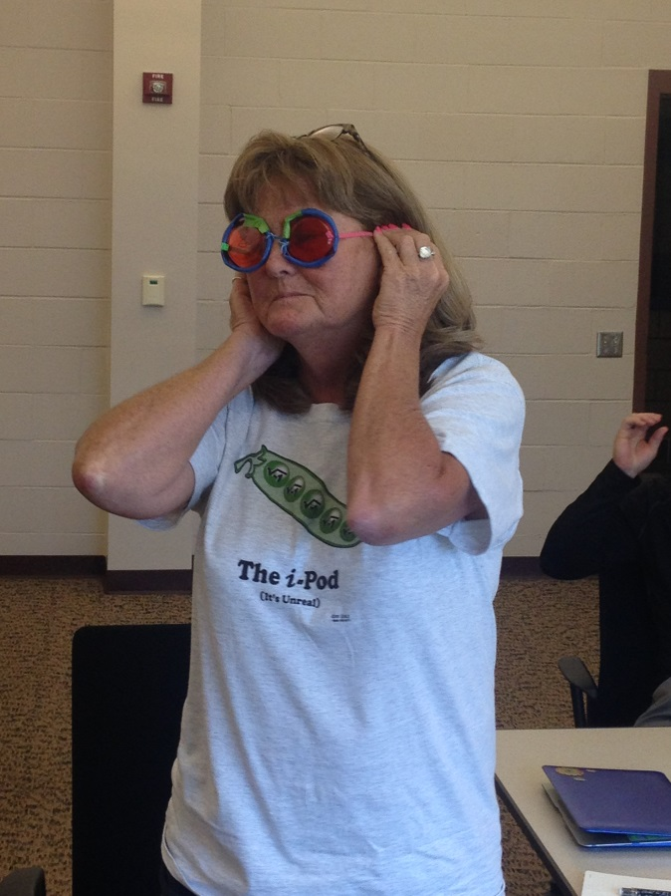
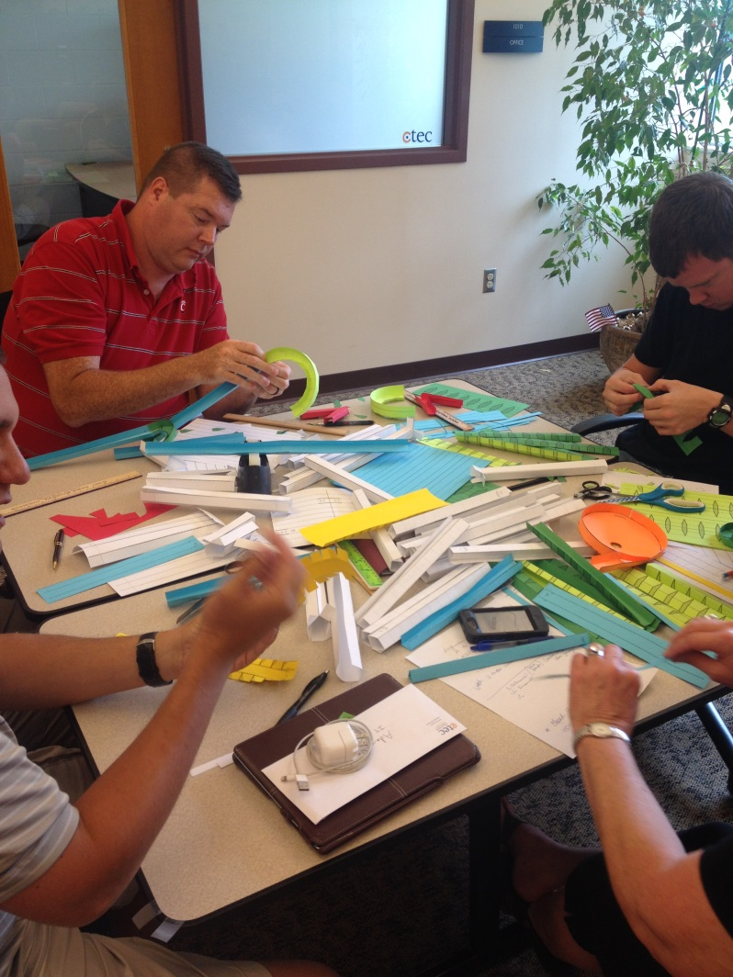
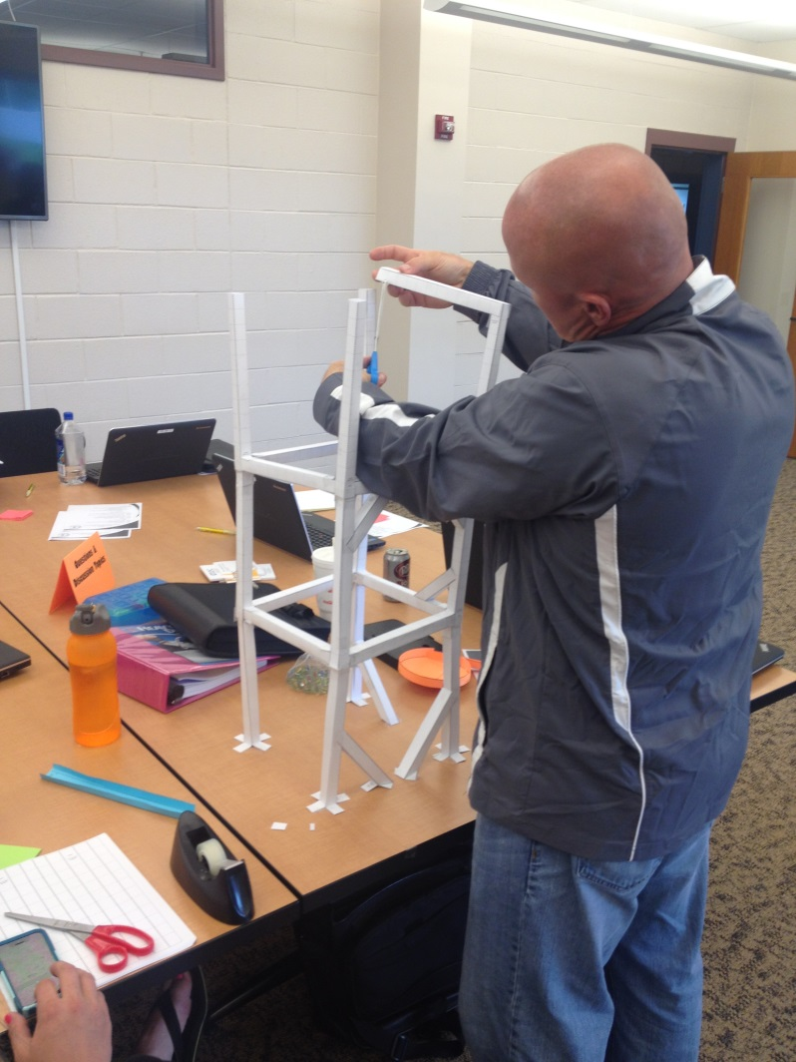
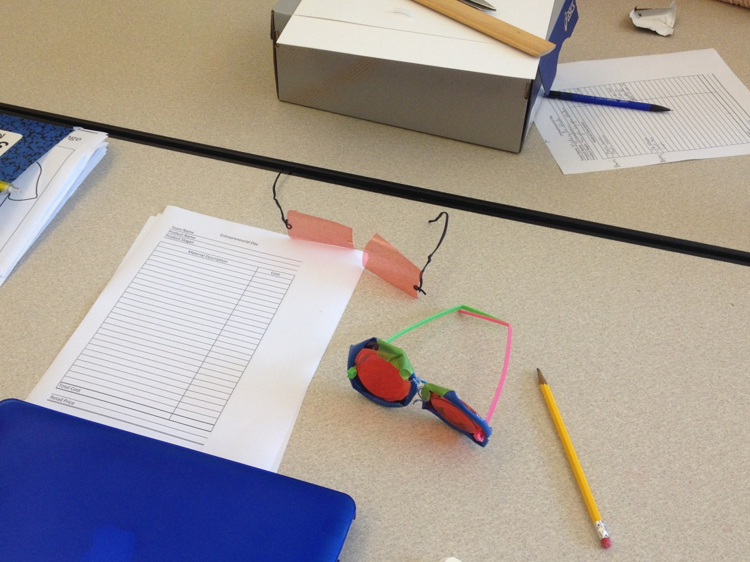

Slide 14
Opportunities for students:
Apprenticeship
Internships
Advanced Job Placement
Early Placement
Shadowing Opportunities

Slide 15


Thank you!
For more information:
On the web visit www.c-tec.edu
Check us out on :
ctec/education
@cteclickingco
QUESTIONS?

