Slide 1
(Pre) Apprenticeships
Shell Nichols, Assistant Director, Ohio Department of Education

Slide 2
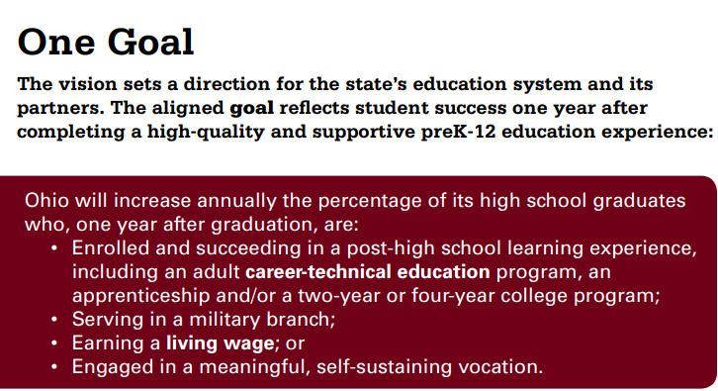

Each Child Our Future
Ohio Strategic Plan
Notes:
Apprenticeships aligns…

Slide 3
Work-Based Learning
Work-Based Learning are experiences are conducted at a work site during or after school. They are designed to provide authentic learning experiences to students that link academic, technical and professional skills. Business and education partners work together to evaluate and supervise the experience, which must be documented with training or learning plans and evaluation forms.
http://education.ohio.gov/getattachment/Topics/Career-Tech/Career-Connections/Work-Based-Learning/Ohio-Work-Based-Learning-Overview.pdf.aspx?lang=en-US
Pre-Apprenticeship is a program that prepares students for on the job training for a formal Registered Apprenticeship training program.
Notes:
Difference from work experience, educators and supervisors co-evaluate them.

Slide 4

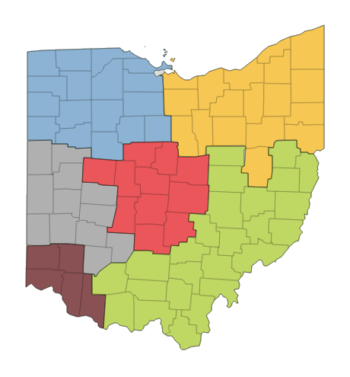
In-Demand Jobs
What are in-demand jobs?
A job that has a sustainable wage and a promising future based on the project number of openings and growth.
80% of state median wage $13.47 per hour or more;
Annual growth in the number of jobs greater than the statewide average of 50; and
Annual job opening greater than the statewide average of 230.

Slide 5
Labor Market Data
https://jobseeker.ohiomeansjobs.monster.com/
https://jobseeker.ohiomeansjobs.monster.com/exploreit/Careers.aspx?action=industry&usertype=mnm&code=62&src=os
https://workforcedatatools.chrr.ohio-state.edu/employmentprojections/
Notes:
K-12 Student Tab, In-Demand jobs, Employment projections occupation table tab

Slide 6
ODE Pre-Apprenticeship Course
990365
Basic technical and job-readiness skills for a designated apprentice occupation – 144 hrs. classroom
Classroom and on-the-job (paid experience) – 120 to 900 hours

Slide 7
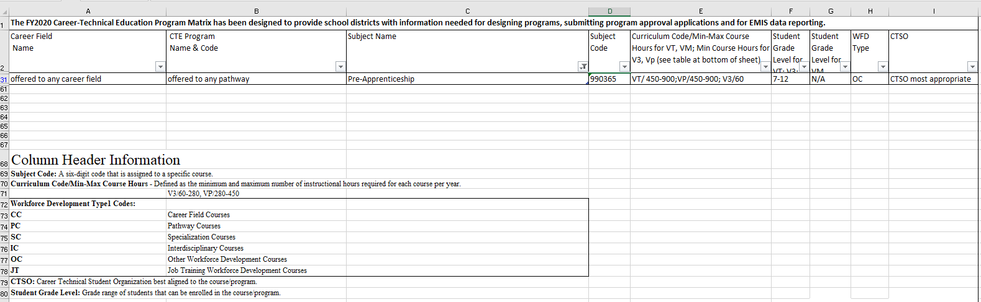
Pre Apprenticeship Course
Notes:
WebXams taken where applicable

Slide 8
Resources
Adecco – CTE/Miscellaneous
Career Connections – Credit Flex/WBL
Education.Ohio.Gov and
Drug Free Clubs of America – www.drugfeeclubs.com

